Slide 1
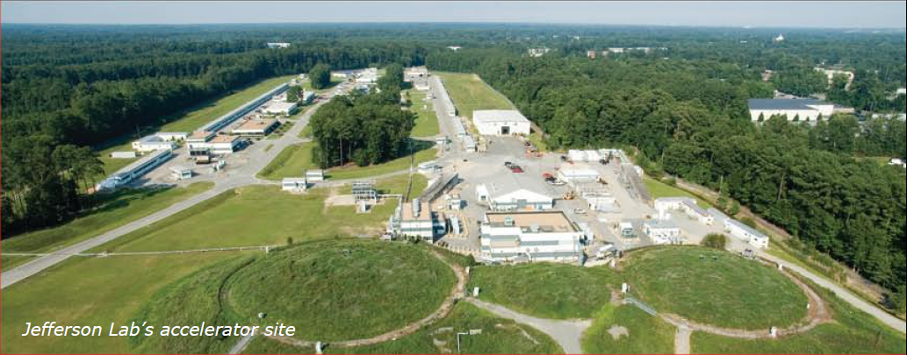
Jlab Status and Charge
Stephen Benson
March 5, 2012

Slide 2
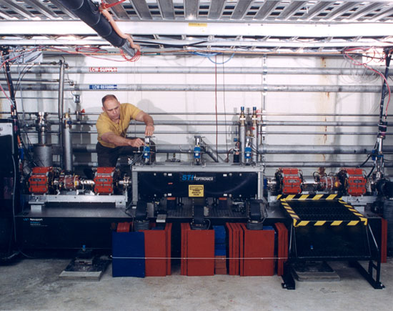
IR Demo
41 periods
Hybrid NdFeB
1.2 cm gap, fixed
K_{rms} = .98
Now installed at Daresbury and converted to variable gap.
Achieved 2.1 kW CW at 3.2 microns

Slide 3
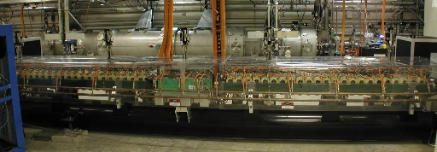
Optical Klystron
  Wavelength 20 cm
  K² 1–16
  Number of periods 12 ea.
  Gap 26 mm
  Polarization vertical
  Phase error <2 deg.
Dispersion section
  Length 58 cm
  Dispersion >40 periods
  for K²=16
  Gap 26 mm
Achieved 10 kW for 1 second pulses at 5.7 microns

Slide 4
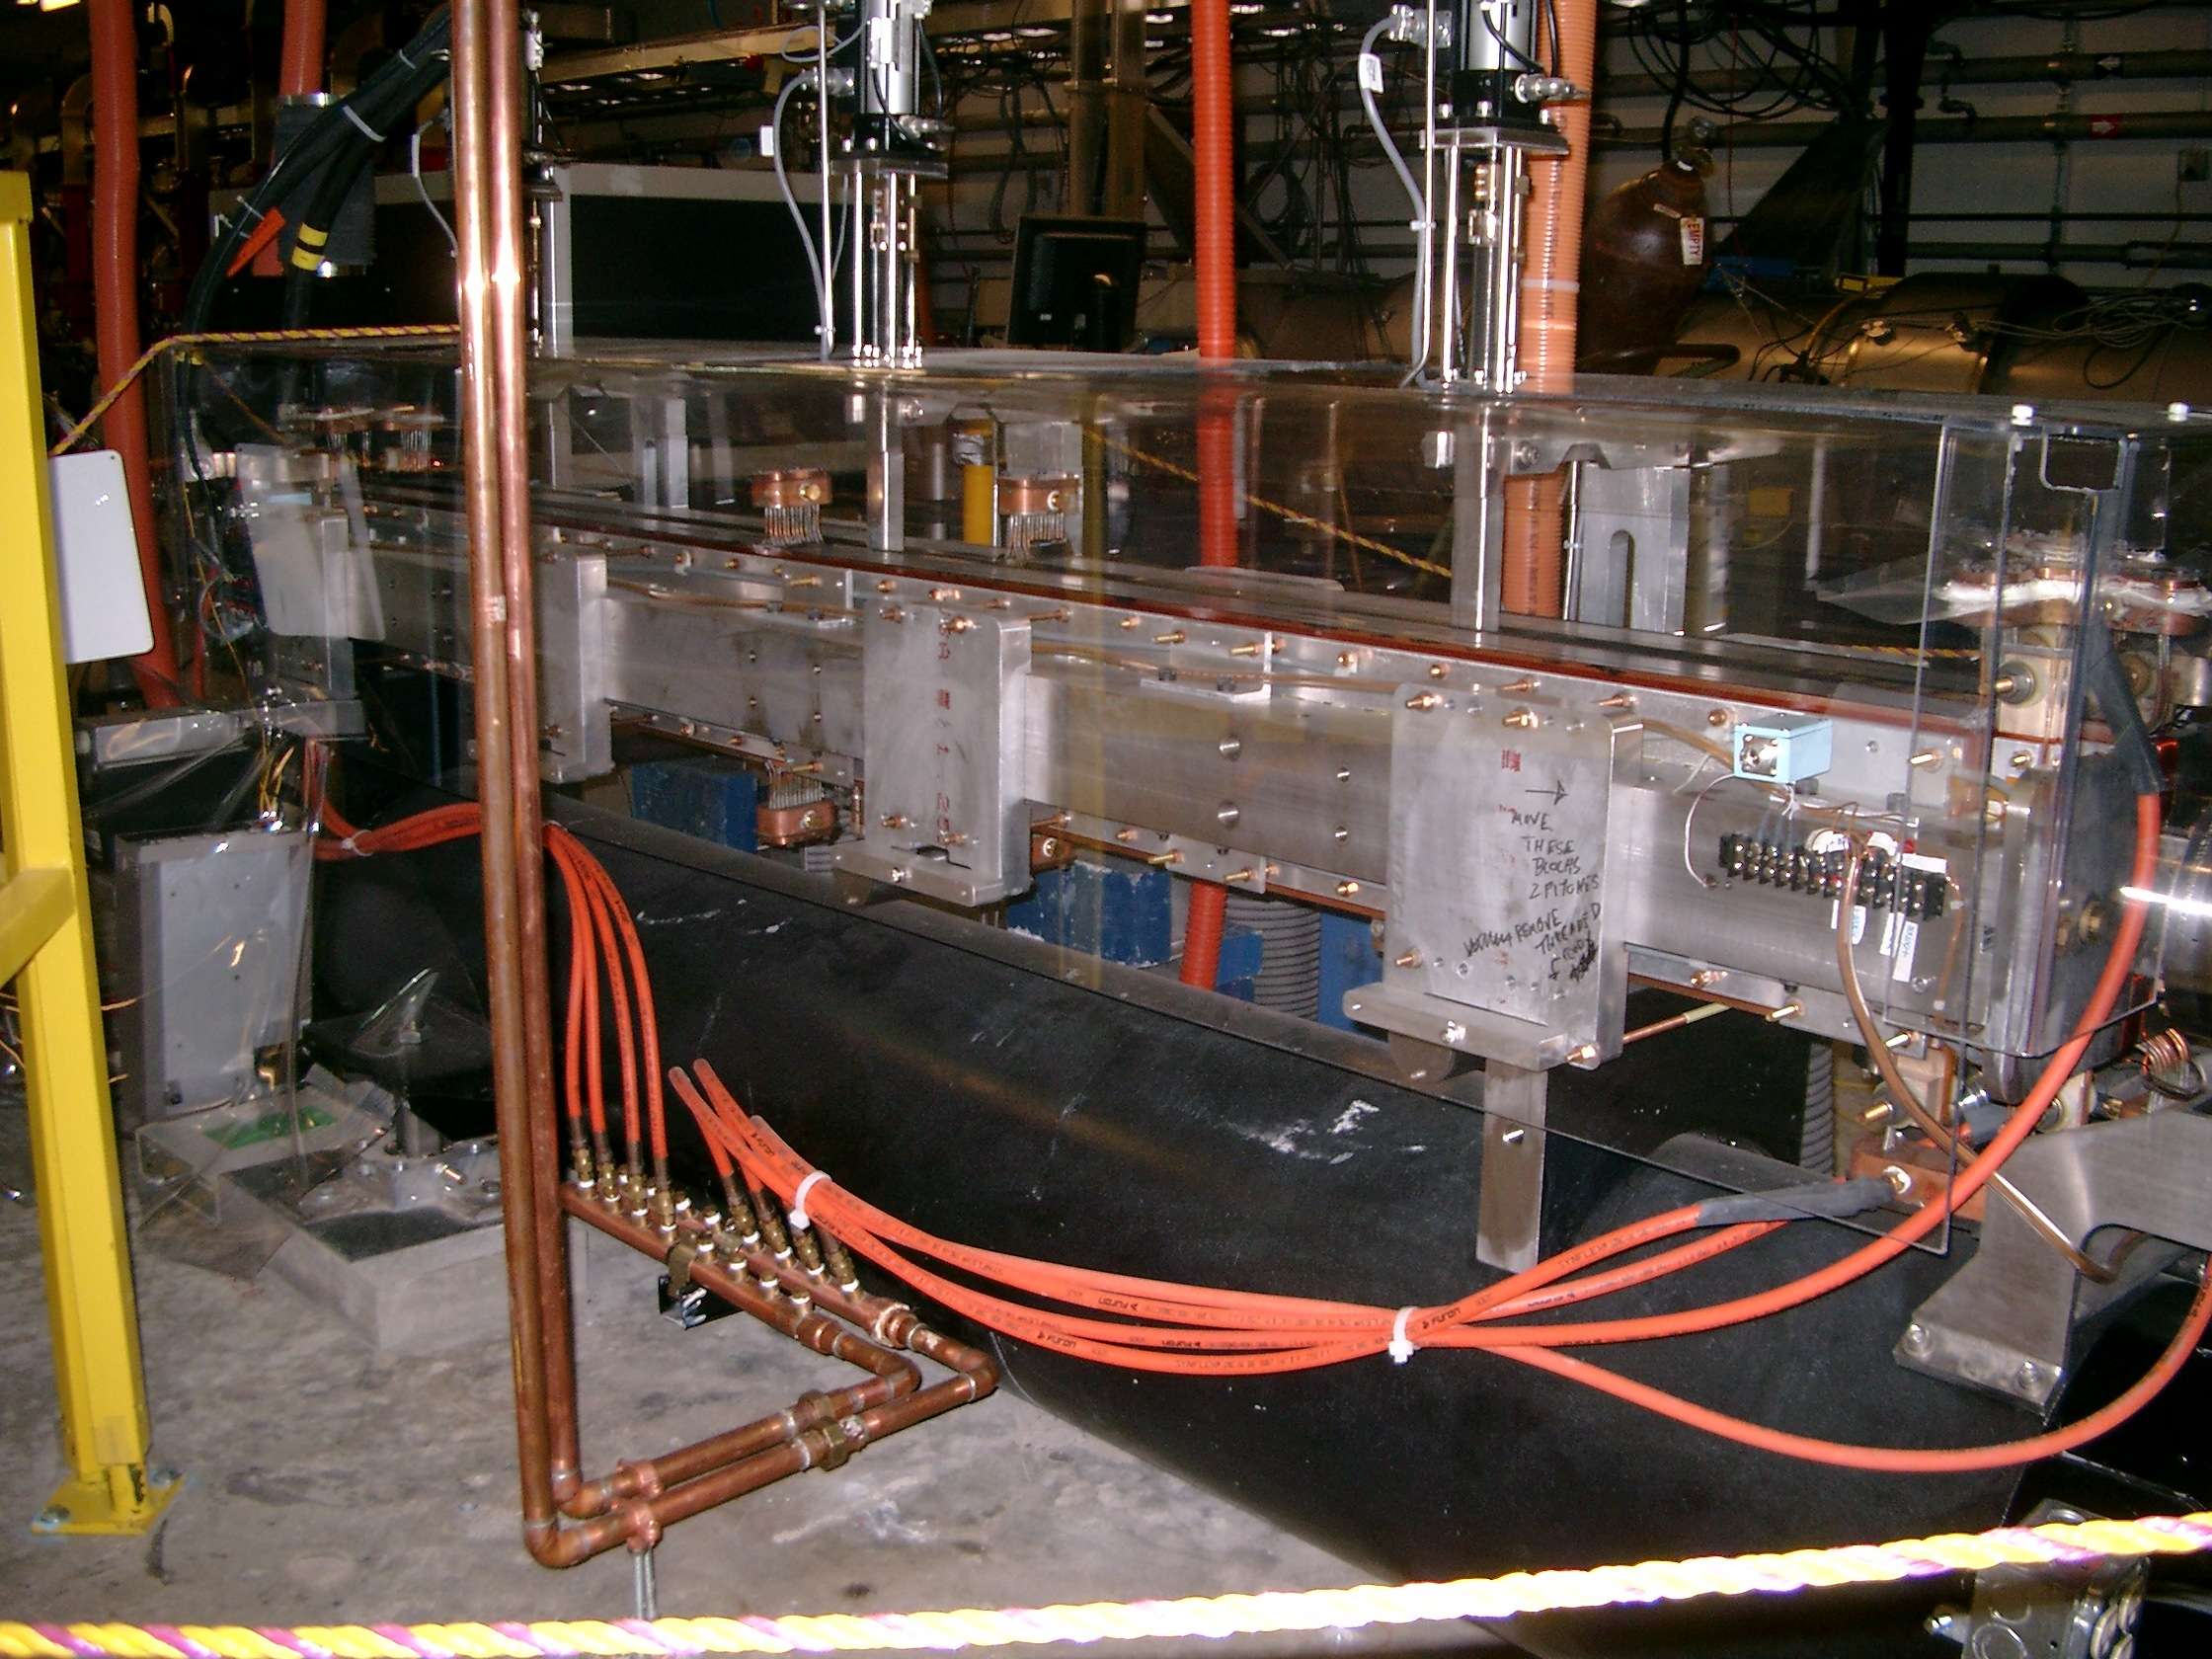
W80 Undulator
29 periods
Electromagnet
8 cm wavelength
K_{rms} = 0.5-1.1
rms phase error less than 1 degree

Slide 5
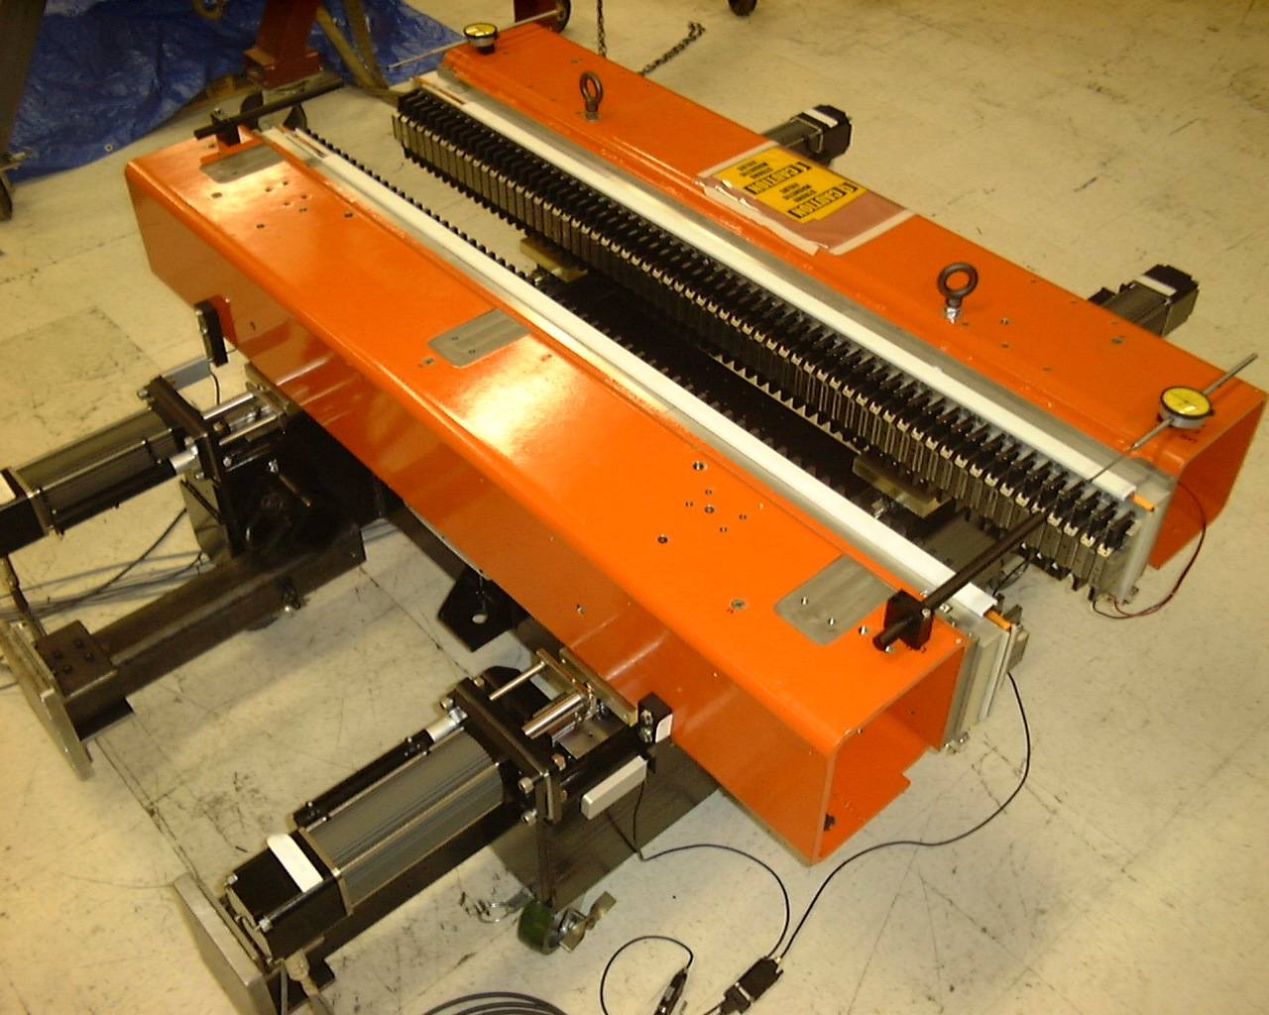
W55 Wiggler
30 periods
Hybrid NdFeB
5.5 cm variable gap
K_{rms} = 0.5-2.95
Currently installed on IR Upgrade
Achieved 14.3 kW CW at 1.6 microns

Slide 6
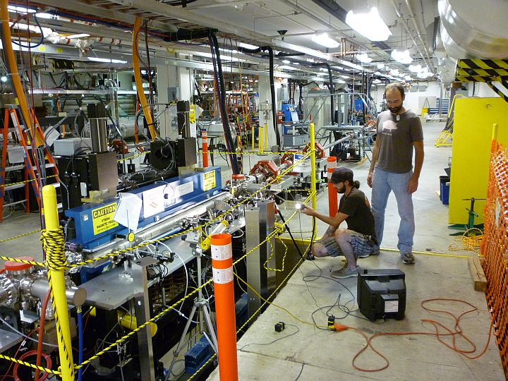
W33 Cornell Wiggler
60 periods
Hybrid NdFeB
3.3 cm variable gap
K_{rms} = 0.5-1.51
Jaws returned to Cornell
Achieved 200 Watts CW at 400 nm, mirror limited

Slide 7
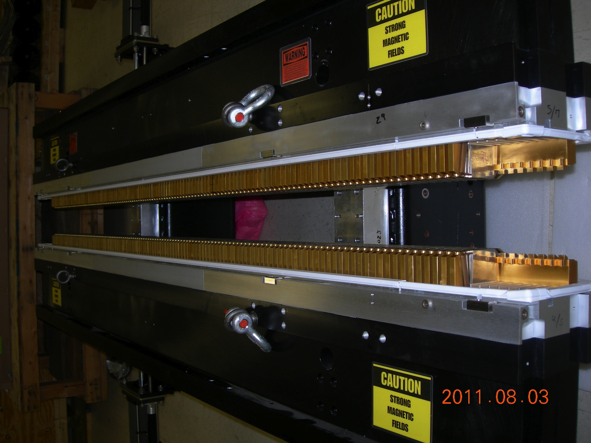
W33 ANL Wiggler
64 periods
Hybrid wedged pole NdFeB
3.3 cm variable gap
K_{rms} = 0.5-1.51
Presently installed on the UV Demo

Slide 8
The Future
To get to much shorter wavelengths with variable polarization we have to go with something like the Cornell Delta undulator design but much longer as proposed in our JLAMP proposal.

Slide 9
Working Group Charge
Working Group 7 – Undulators
Evaluate present limitations of undulator capabilities and derive new concepts and technologies that alleviate these limitations for both linearly and circularly polarized undulators.
Consider methods to greatly improve the robustness of operation and to lower the cost of building and operating long, high quality undulators.

